Slide 1
NFL Quarter Back Analysis 2000- 2015
MICA team:
Mike Jackson, Inder Grang, Chris Conner , Abby Kannappan

Slide 2
Objective and Outline
Objective: Study the past 20 years of NFL Quarterback data and find answer to this question:
Is it worth it to draft and pay for a first round pick? Which round is the best one to draft a quarterback?
Presentation Outline
Data Sources and Cleansing
Data Evaluation of draft data
Draft round data vs NFL performance metrics
NFL performance statistics vs Player Salary
Data Outliers
Conclusions

Slide 3
Data Sources and Cleansing (Inder)
Data was gathered from www. ??
Started with top 100 quarterback data from 2000-2015. Data was saved in 100_stats.csv
Went to www.?.com to get their salaries per year from 2001 to 2020. Information was available per year and saved in separate csv. Used pandas to merge data for all 20 years into a single frame. Exported data in population_salaries_by_season.xlsx
Merged the data from 100_stats.csv and population_salaries_by_season.xlsx into a single file called raw.csv. It had player data as well as their salary information for each year.
Some players didn’t have salary information and so had to be dropped from the analysis. At the end, 88 players were used for analysis.
Input files can be found in Resources/ folder
Cleaning jupyter notebooks are:
Mike: Can you please share your jupyter files and input/output files?
data_cleanup.ipynb (input file: Resources/Obsolete/100_stats.csv, Resources/Obsolete/population_salaries_by_season.xlsx, Output: Output/raw.csv)
Data Analysis was done on raw.csv and static_data.csv

Slide 4
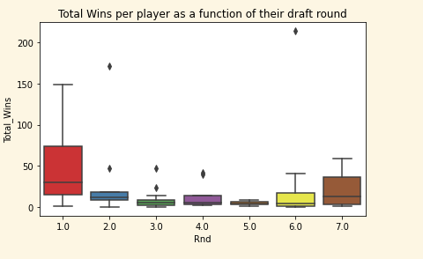
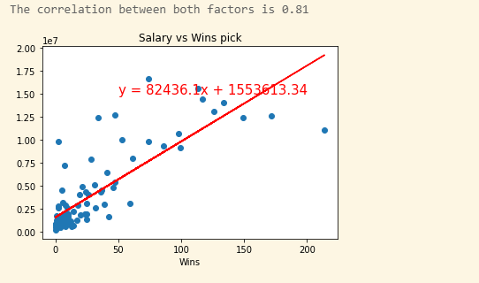
Initial data analysis (Inder)
Merged static_data.csv and raw.csv in a merged data frame using “Player” name as the pivot column.Fixed column names and selected a subset of the columns for analysis
Used groupby() and describe() to focus on players.
Here is seaborn box plot of Total wins vs. Round pick.
Here is a linear regression of salary vs number of wins
Correlation coff is 0.81 which means strong correlation
Most of the players got picked at age of 22 or 23
Mike, you can modify or merge
this in your slides

Slide 5
Evaluation of Draft Data (Chris)

Slide 6
Draft Round data vs. NFL performance Stats (Abby)

Slide 7
NFL Performance vs. Salary (Mike)

Slide 8
Data Outliers (Mike)

Slide 9
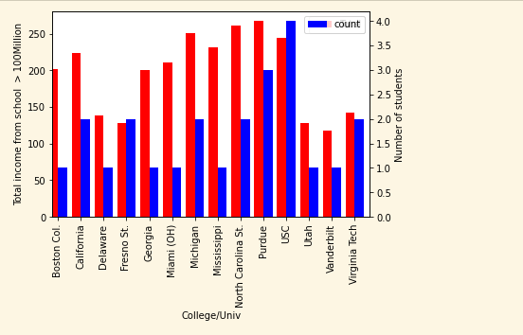
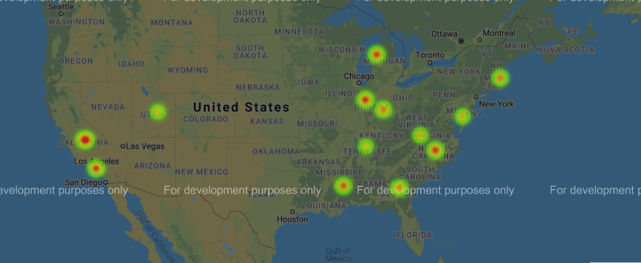
School Statistics and Gmaps
Here is bar graph and heat map of schools that had players generate > 100million along with number of players per school. Top schools are:
USC
Purdue
NC State
Mississippi State?
Univ of Michigan, Ann Arbor
UCLA?

Slide 10
Conclusions (Mike)
Data gathering is non-trivial. Salary information for players needed subscription
Drafting in 3rd, 4th and 5th round is not statistically favorable.
Drafting a QB in the first round provides the most value when you look at $ per win.

